Slide 1
Computer vision for industrial inspection
NVIDIA DLI

Slide 2
Workshop Outline
Lab 1 | Automated Optical Inspection and Data Exploration Discuss automatic optical inspection, PCBA process, and current challenges of AOI machines on high false positives Perform EDA on real dataset from GPU production line Scope into short-term DL automation problem
Lab 2 | Model Training with Transfer Learning Apply transfer learning with ResNet-50 architecture Fine-tune the model and set up evaluation metrics Apply augmentation technique to solve heavily imbalanced dataset Examine a confusion matrix and fine-tune results based on domain-expert tunable thresholding
Lab 3 | Model Deployment for Inference Compile trained ResNet-50 model as TensorRT engine Deploy TRT engine to Triton Inference Server Experiment various inference configurations to optimize performance
Assessment

Slide 3
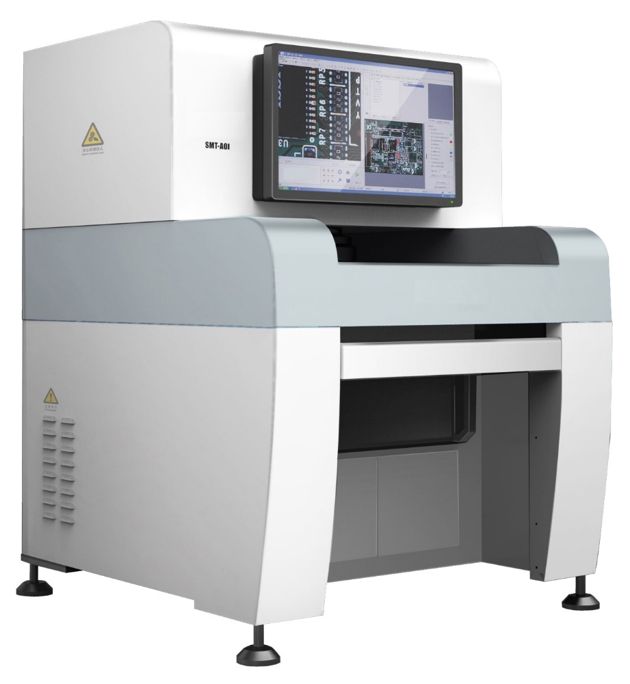
Challenges with AOI
Very High False Positive Rate & Non-Robust/Non-Reliable Detection Require Human Verification
AOI machine employs traditional CV algorithms
False positive rate can be up to 70%
Reduced throughput
Requires tedious manual inspection by human operator
Reliability problems
Increased cost
Requires frequent and costly manual algorithm tuning
???

Slide 4
DL-Based Solution Development workflow
Rapid Prototyping for Production
Scoping
Data Curation
Experimentation
Deployment
Model Development
Training
Inference
Train Set
Validation
Define the Problem
Gather Data
Data Curation
Model Evaluation
Deployment
Validation Set
Satisfied
Not Satisfied
Re-train
Monitoring
Data Drift Detected

Slide 5
AGENDA
Lab 1 - Automatic Optical Inspection and Data Exploration
Lab 2 – Model Training with Transfer Learning Apply augmentation technique to solve heavily imbalanced dataset Apply transfer learning with ResNet-50 Fine-tune the model and set up evaluation metrics Examine a confusion matrix and fine-tune results based on domain-expert tunable thresholding
Lab 3 – Model Deployment for Inference
Assessment

Slide 6
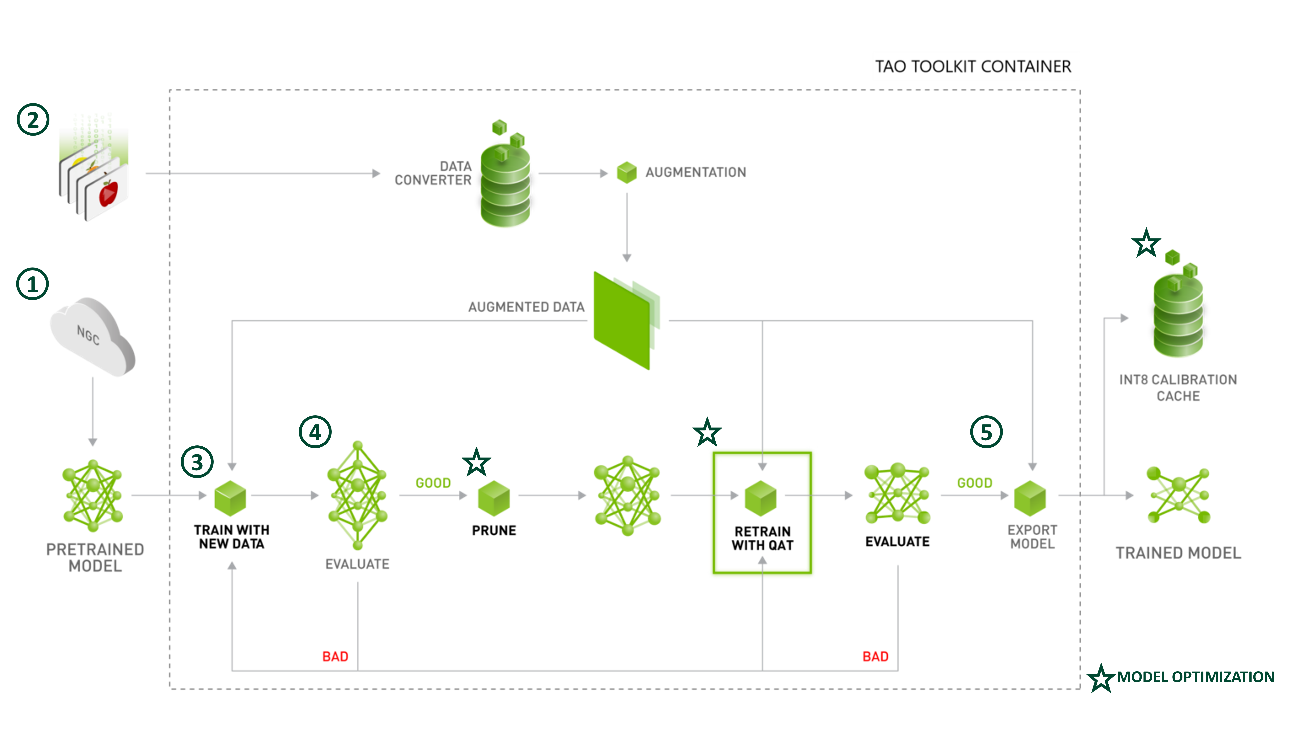
NVIDIA Train Adapt Optimize (TAO) Toolkit
Simplifies the AI/ML Model Development Workflow
Workflow:
Download pre-trained model
Prepare the data
Efficiently train model
Evaluate model performance
Export model

Slide 7
Using Transfer Learning
“If I have seen further, it is by standing on the shoulders of giants.”
-Isaac Newton
Transfer Learning abstracts and accelerates deep learning training by allowing developers to fine-tune the pre-trained models (that are domain-specific), instead of going through the time-consuming process of building Deep Neural Networks (DNNs) from scratch

Slide 8
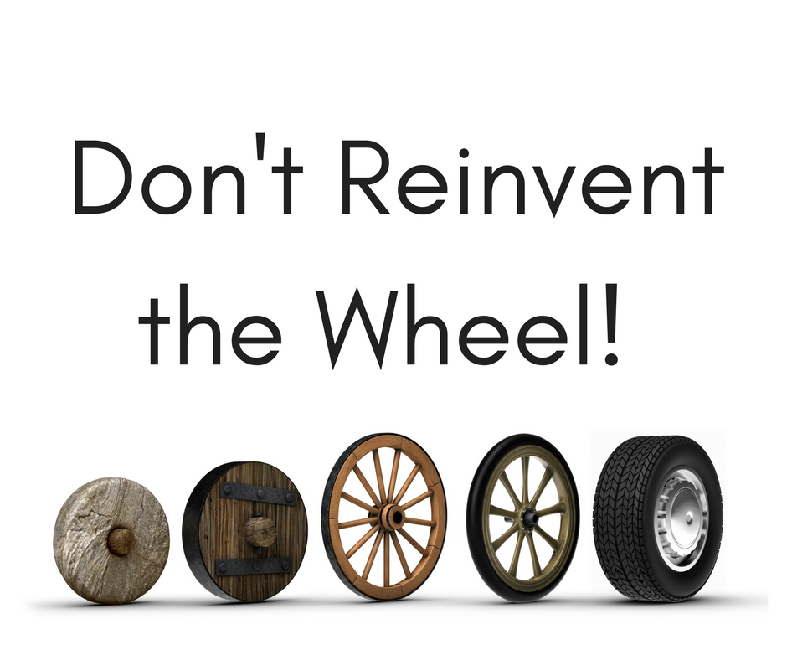
Stand on top of it and perfect it!

Slide 9
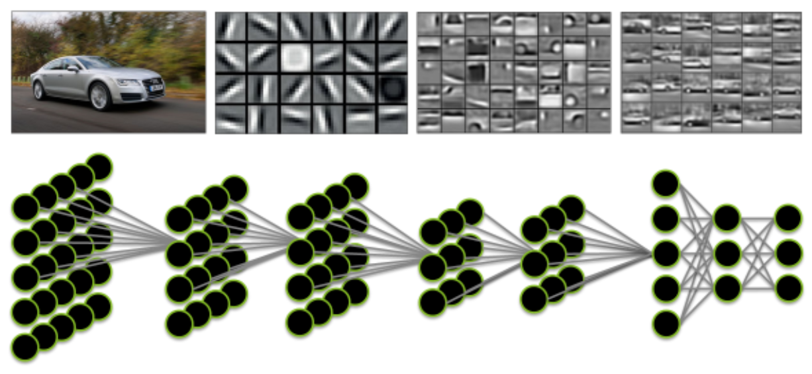
How a deep neural network sees
Transferring Learned Features from One Model to Another

Slide 10
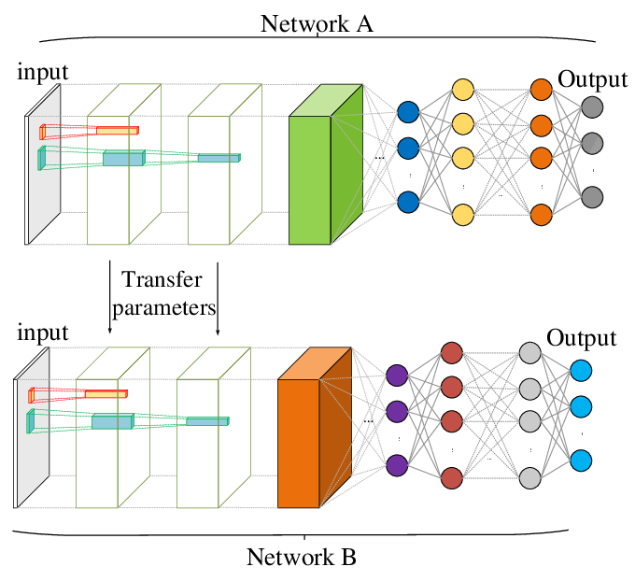
Transfer Learning Explained
B Takes Advantage of First Layers Trained in A and Last Layers are Re-Trained for New Task
Start with a pre-trained deep learning model
Within the neural network are layers that are used to identify outlines, curves, lines, and other identifying features
Delete what’s known as the “loss output” layer, which is the final layer used to make predictions, and replace it with a new loss output layer for custom prediction
Apply additional training by feeding labeled training data for custom task
This loss output layer is a fine-tuning node for determining how training penalizes deviations from the labeled data and the predicted output

Slide 11


Benefits of Transfer Learning
Shorten the lengthy process of training a large model with potentially tens of millions of parameters
Reduce cost of acquiring the amount of data to train a full model as it is often prohibitively expensive in industrial use cases
Reduce the amount of data needed for training under the constraint of not enough data

Slide 12
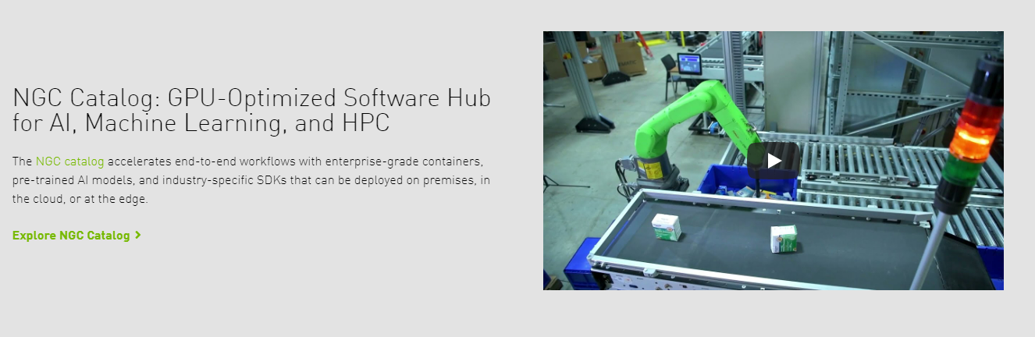

NGC – NVIDIA GPU CLOUD
Pre-Trained Models From the NGC Catalog Cover a Wide Set of Use Cases
Image classification supports various backbones such as resnet, vgg, googlenet, mobilenet, squeezenet, darknet, efficientnet, and cspdarknet

Slide 13
Model evaluation
How to Measure Model Accuracy
Accuracy rate provides an overview of how well the model is performing:
True Positive (TP): model correctly classifies the input as defect
False Positive (FP): model incorrectly classifies the input as defect
False Negative (FN): model incorrectly fails to classify the input as defect
True Negative (TN): model correctly fails to classify the input as defect
We need more insights into accuracy, especially if the dataset is imbalanced, and we need to compromise some aspects of accuracy rate in favor of others

Slide 14
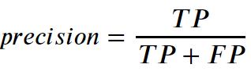
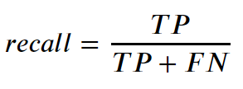
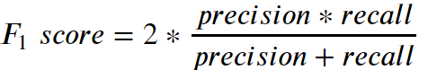
Model Evaluation
Precision, Recall, and F1 Score
Precision – the model’s ability to identify the relevant samples only
Recall - the model’s ability to identify all true positive samples of the dataset
F1-Score – harmonic mean of precision and recall
Is generally considered a better overall measurement than accuracy when an uneven class distribution exists

Slide 15
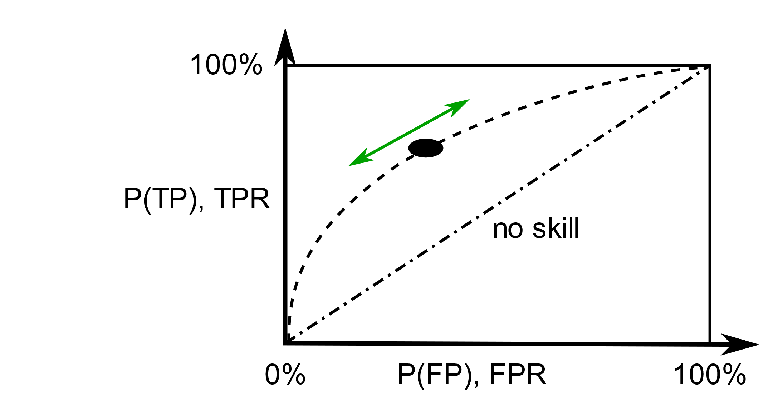
ROC Curve
ROC Curve Shows Performance of a Classification Model at All Classification Thresholds
The method was originally developed for operators of military radar receivers during World War II
Created by plotting the true positive rate (TPR) against the false positive rate (FPR) at various thresholds, which depicts relative trade-offs between the two
Provides tools to select possibly optimal model and/or classification threshold

Slide 16
Fine-Tuning Model
Iteratively Curate Data to Improve Model Performance
Train Model
Error Analysis
Tune Model and Data

Slide 17
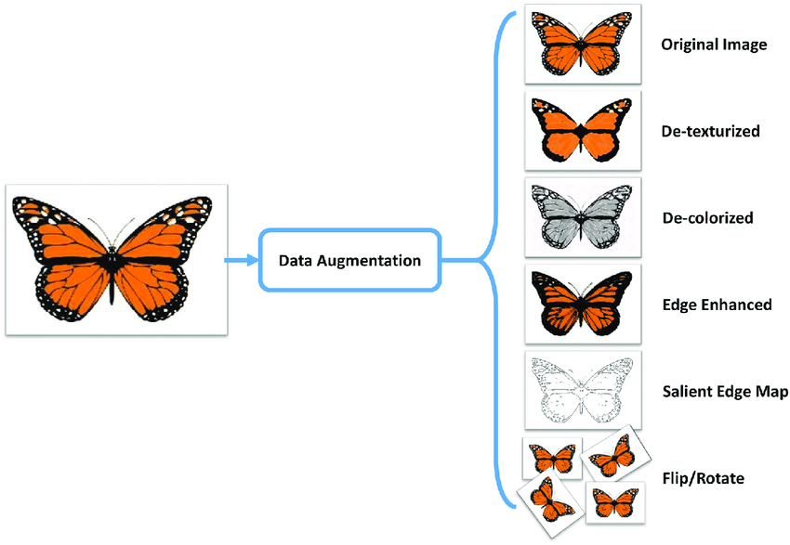
Data Augmentation
Data Can Be Rare and Expensive to Acquire
Artificially increase sample size by introducing random perturbations like change of color, temperature, flipping, translation, and so on.
In practice they often marginally improve performance
Augmentation can be done online during training or offline

Slide 18
End of lab 2

Slide 19
Lab 1 Summary
Discuss Automatic Optical Inspection, PCBA process, current challenges of AOI machines on high false positives
Analyze, manipulate, and visualize real dataset from GPU production line
Examine labeling of data obtained from AOI machine and curating dataset further
Scope into short-term DL automation problem

Slide 20
Lab 2 summary
Apply transfer learning with ResNet-50 to train a custom classification model
Download pre-trained model/architecture from NGC
Apply augmentation technique to solve heavily imbalanced dataset
Fine-tune the model and setup evaluation metrics
Examine a confusion matrix and fine-tune results based on domain-expert tunable thresholding
Iterate “data curation – model training – error analysis” to further improve performance and reduce false positive rate

Slide 21
What’s Next (Lab 3)
Compile trained ResNet-50 model as TensorRT engine
Deploy TRT engine to Triton Inference Server
Send inference request to server
Compare the performance improvement using various inference configuration

